Slide 1
APACHE SOLR, APACHE NUTCH AND SEARCH ENGINE
Abhay Kumar

Slide 2
TABLE OF CONTENTS
Search Engine
Apache Nutch
Nutch Details
Apache Solr
Solr Details
References

Slide 3
SEARCH ENGINE
The information may be a mix of webpages, images and other types of files. Example : Google, Yahoo.
Search engines are important because with over 8 billion web pages available, it would be impossible to search for the information that is specifically needed.
This is why search engines are used to filter the information that is on the internet and transform it into results that each individual can easily access and use within the matter of seconds.
Types of Search Engines
  Crawler Based Search Engines: These types of search engines use a “spider”, “robots” or a “crawler” to search the Internet. The crawler digs through individual web pages, pulls out keywords and then adds the pages to the search engine's database.
  Directories: Directories are human powered search engines. A website is submitted to the directory and must be approved for inclusion by editorial staff.
  Hybrid Search Engines: Hybrids are a mix of crawlers and directories. Sometimes, you have a choice when you search whether to search the Web or a directory. Other times, you may receive both human powered results and crawler results for the same search.
  Meta Search Engines: Meta search engines are ones that search several other search engines at once and combines the results into one list. While you get more results with meta search engines, the relevancy and quality of the results may sometimes suffer.

Slide 4
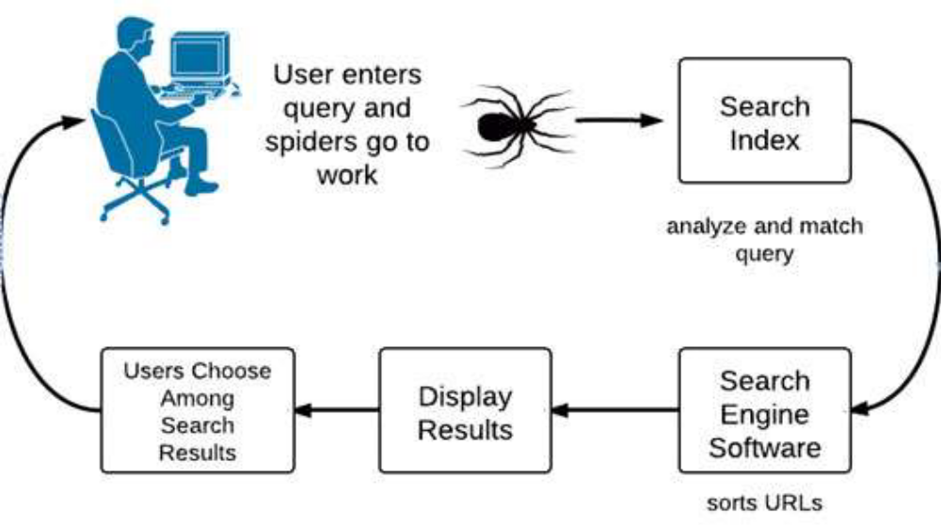
WORKING OF SEARCH ENGINE

Slide 5
APACHE NUTCH OVERVIEW AND ARCHITECTURE
A full-fledged web search engine
Functionalities of Nutch
  Internet and Intranet crawling
  Parsing different document formats (PDF, HTML, XML, JS, DOC,PPT etc.)‏
  Web interface for querying the index
  Management of Recrawls
4 main components
  Crawler
  Web Database (WebDB, LinkDB, segments)‏
  Indexer
  Searcher
Crawler and Searcher are highly decoupled enabling independent scaling
Highly modular, Plugin based architecture.

Slide 6
STEPS IN A CRAWL + INDEX CYCLE
Create a new WebDB (admin db -create).
Inject root URLs into the WebDB (inject).
Generate a fetchlist from the WebDB in a new segment (generate).
Fetch content from URLs in the fetchlist (fetch).
Update the WebDB with links from fetched pages (updatedb).
Repeat steps 3-5 until the required depth is reached.
Update segments with scores and links from the WebDB (updatesegs).
Index the fetched pages (index).
Eliminate duplicate content (and duplicate URLs) from the indexes (dedup).
Merge the indexes into a single index for searching (merge).

Slide 7
WEB DATABASE (WEBDB)‏ AND PAGE DB
Persistent data structure for mirroring the structure and properties of the web graph being crawled
The WebDB stores two types of entities
  Pages
  Links
Optimised for frequent updating
Page Database
  used for fetch scheduling
  Contains:
    pages indexed and sorted by MD5 and URL
    outlinks, fetch information, page score
A set of APIs are provided to perform the various operations

Slide 8
LINK DB AND SEGMENTS
Link Database
  Contains:
    links sorted by MD5
    links sorted by URL
  Represents full link graph.
  Stores anchor text associated with each link
  Used for:
    Link analysis;
    Anchor text indexing.
Collection of pages fetched and indexed by the crawler in a single run
One segment dir for each crawl-fetch-update cycle at a particular depth
Contains raw text and parsed data of the files crawled
Used to return the cached copy of a page and in snippet generation in results page

Slide 9
PLUGINS
Provide extensions to extension-points
Each extension point defines an interface that must be implemented by extension
Some core extension points
  IndexingFilter: add meta-data to indexed fields
  Parser: to parse a new type of document
  NutchAnalyzer: language specific analyzers

Slide 10
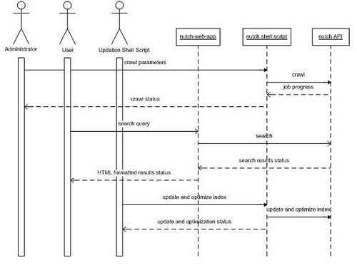
NUTCH API

Slide 11
APACHE SOLR AND HISTORY
Apache Solr is a popular, open source enterprise search platform built on the Java based search engine library Apache Lucene.
Solr powers the search and navigation features of many of the world's largest companies like Netflix,Instagram, Linkedin, Twitter and eBay, etc.
2004: Solr was created by Yonik Seeley at CNET Networks (In house)
2006: CNET Networks donated it as an open source project to the Apache Software Foundation
2008: Solr 1.3 was released including distributed search capabilities
2009: Solr 1.4 with enhancements in indexing, searching and faceting
2010-11: Apache projects Lucene and Solr were merged. And to keep both on same version number, the next release after Solr 1.4 was labeled as Solr 3.1
2012: Released Solr 4.0 with the new SolrCloud feature.
2015: Released Solr 5.0 where Solr was packaged as a standalone application – No more need to deploy as war.
2016: Release Solr 6.0 with support for Parallel SQL queries
2017 : Release Solr 7.0 with multiple replica types, auto-scaling and a Math engine
2019 : Release Solr 8.0 with bugfixes and component updates. Solr nodes can now listen and serve HTTP/2 requests.

Slide 12
SOLR AND ITS BUILDING BLOCKS
Uses the Lucene library for advanced full-text search
● XML, JSON and HTTP support
● Comprehensive Admin UI
● Distributed Search through Sharding - enables
scaling content volume
● Easy configuration
● Queries, filters, and documents

Slide 13
BUILDING BLOCKS OF SOLR
Request Handler
– e.g. /select, /update
● Search Component
– e.g. query, faceting, grouping
● Query Parser
– verifies the queries for syntactical errors
– translates them to a format which Lucene understands.
● Response Writer
– e.g. XML, JSON, CSV
● Analyzer/tokenizer
– Analyzer: examines the text of fields and generates a token stream.
– Tokenizer: Breaks the token stream into tokens.
● Update Request Processor
– responsible for modifications such as dropping a field, adding a field

Slide 14
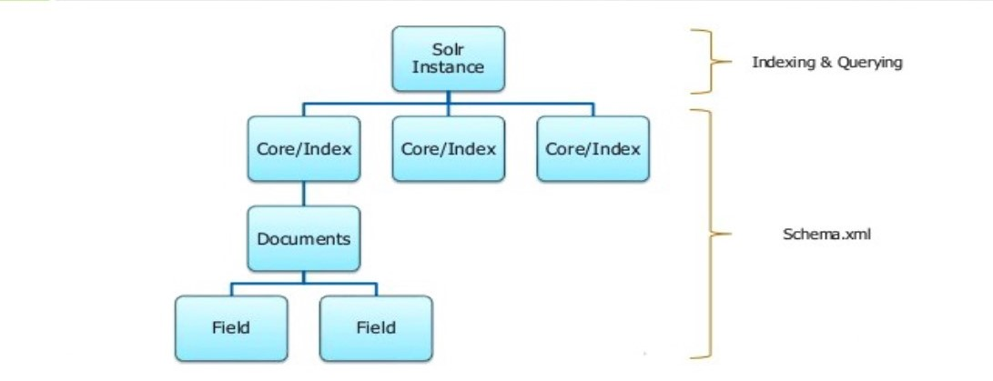
SOLR SCHEMA HISTORY

Slide 15
REFERENCES
https://cwiki.apache.org/confluence/display/solr/Apache
https://www.tutorialspoint.com/apache_solr/
http://lucene.apache.org/solr/
https://en.wikipedia.org/wiki/Web_search_engine
https://www.tutorialspoint.com/apache_solr/
http://lucene.apache.org/nutch/
https://nutch.apache.org

